Slide 1
docker swarm setup
Windows server 2016 version 1709
With router mesh
February, 2018

Slide 2
Demo assumptions
General knowledge of Docker container architecture
General knowledge of Docker swarm architecture
General knowledge of Visual Studio
General knowledge of Hyper V

Slide 3
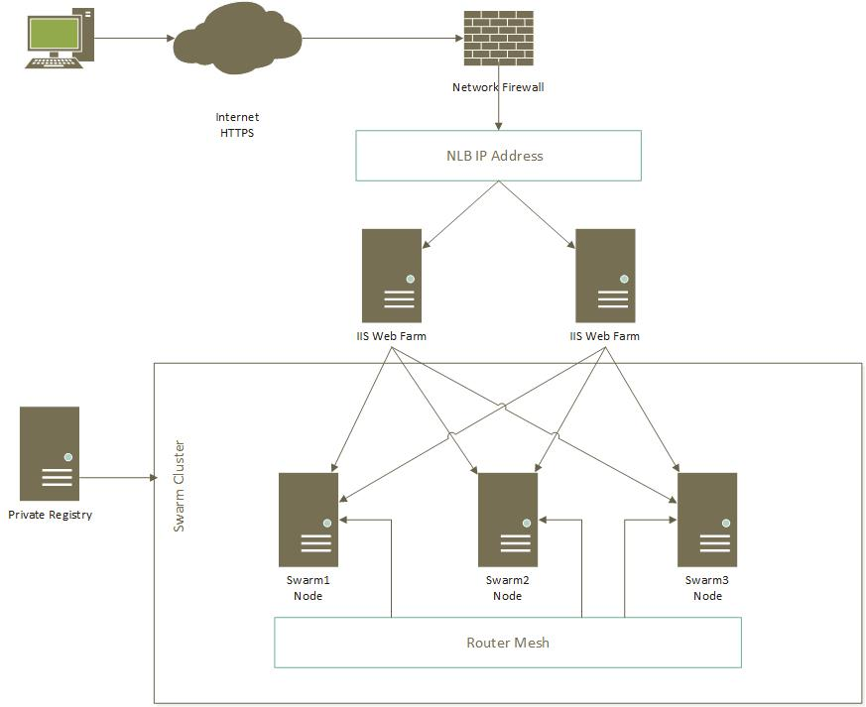
Swarm architecture

Slide 4
demo goals
Setup Docker Swarm with Router Mesh
Set up two Windows Server 2016 Version 1709 VM
Configure Servers and install Docker
Create Docker Swarm Cluster
Join node to Swarm
Create swarm service
Scale service
Demonstrate rolling updates and rollbacks
Demonstrate node failure
All steps shown. Nothing skipped.

Slide 5
Start demo

Slide 6
Demo wrap up
Artifacts available: https://github.com/zero2heroseries/dockerswarm
Email: zero2heroseries@gmail.com
Please leave any comments or suggestions
Hope you enjoyed the demo

